Slide 1

PERSONAL VISUAL ASSISTANCE DEVICE
BY TEAM -COD-ECT-

Slide 2
TEAM MEMBERS
AMAL GEORGE
FARAS MOHAMMED
JEEVAN JOLLY
LAILA N A

Slide 3

IDEA
To help the visually impaired live a better life by creating a device that helps them navigate accurately in this world using sensors , realtime obstacle mapping global positioning system and internet of things.

Slide 4
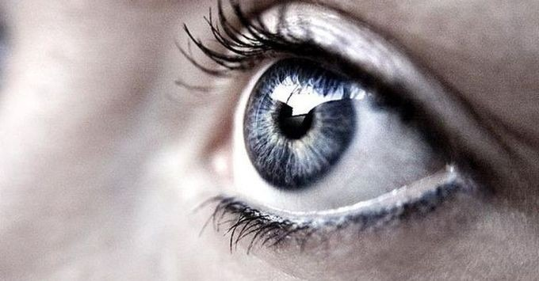
SOCIAL RELEVANCE
Per year, approximately 185 000 corneal transplants were performed in 116 countries, and 284 000 corneas were procured in 82 countries. With an estimated 12.7 million people waiting for a corneal transplantation, 1 in 70 of the needs are covered worldwide.
This device will help overcome this obstacle of both shortage and unaffordability of eye transplants , thus providing an alternate solution to the blind population .

Slide 5
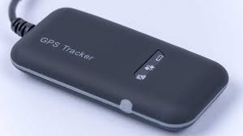
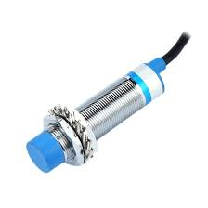
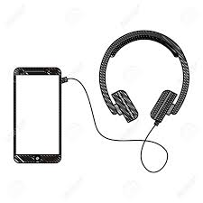
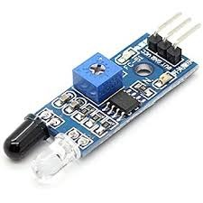
MATERIALS REQUIRED
2 PROXIMITY SENSORS GPS MODULE
INFRARED OBSTACLE DETECTION CAMERA SMARTPHONE AND HEADSET

Slide 6
WORKING
The 2 sensors fitted on the footwear can calculate the distance of separation between them accurately and can hence measure the length of each stride of that person .
This data connected to a GPS system can help a blind person navigate accurately in real time
The infrared cameras located on the front and back of a person will help them be aware of the obstacle around them .
This can be achieved with the help of image recognition softwares and algorithms .
All this data will be collected in an app for processing and future uses.
The earphones will transfer the voice commands to the person .
Extreme accuracy helps the person navigate much more safely and independently .
Also ,connecting this device to the home appliances and to a voice assistant will let the blind person handle home much more efficiently
This can be done using IOT algorithm .

Slide 7
COST EFFICIENCY.
Cornea transplant in India usually costs around $2000 (₹1,30,000) , with the global average around the same .
Since most of the visually impaired are above 60 years , they cannot afford the highly expensive eye transplants .
This device can be created with an average budget of Rs 15,000 which can be lowered even further by further technological developments .

Slide 8
CONCLUSION .
The Personal Visual Assistance Device (PVAD) being highly cost effective will be a boon to the poor .
This device will help the visually impaired be self sufficient and with further developments in the future help them become truly independent .

Slide 9

THANK YOU

